Slide 1
Tweets purification
CS246
Jennifer Zhang
Zijun Xue
Wen Shi

Slide 2
Dataset
Twitter
GET statuses/sample
~800 000 tweets
~120 000 distinct words (excluding hashtags, usernames, urls)
Dictionary - Ispell

Slide 3
Single Word Correction
Single word abbreviation
Squeeze
Gathering correction candidates:
Edit distance
Soundex
Metaphone
Filtering using letter similarity
Eliminating duplicates
Scaling via candidate frequency
Dictionary

Slide 4
Single Word Abbreviations
Manually maintained list of special abbreviations
Potential 1-to-many mapping
fb = facebook
ig = instagram
2 = [to, two, too]
ur = [your, you’re]
Cross-checked most frequent words against dictionary

Slide 5
Edit Distance Candidates

Slide 6
Phonetic Corrections
How to correct misspelling caused by typing a query that sounds like the target term?
– Example: Hermann and Herman
How to correct misspelling caused by typing a query that sounds like the target term
“phonetic hashing” – similar-sounding terms are hashed to the same value
Algorithms
American Soundex
Metaphone
NYSIIS (New York State Identification and Intelligence System)

Slide 7
Soundex Algorithm
Idea
Vowels are viewed as interchangeable in transcribing names
Consonants with similar sounds (e.g., D and T) are put in equivalence classes so related names often have the
Algorithm:
Turn every term to be indexed into a four-character:
Example: Hermann ： H655, Herman ： H655, matched!
Example:
Soundex_Dict(“people”): p140
Inverted_Soundex_Dict(p140): [ ‘peaple’, ‘peopleeee’, ‘piebbal’, ‘people', 'peple', 'pupil’,'puffle', 'peoople','peoplle', 'pueblo', 'phaphela', 'pahabol’ ,'people", 'people', 'payable', 'paypal', 'peopleee', 'pablooo', 'papell', 'poeple', 'poweful', 'peopl', 'papal', 'pablo', 'pavel', 'peoiple', 'peoplee', ‘people', 'pebble']

Slide 8
Metaphone Algorithm
Idea
It fundamentally improves on the Soundex algorithm by using information about variations and inconsistencies in English spelling and pronunciation.
Example: “Smith” [ SM0, XMT], “Schmidt” [XMT, SMT]-> both have XMT in common.
Example:
doublemMetaphone_Dict(“people”): [“PPL”, “”]
Inverted_Metaphone_Dict(“people”):[ ‘peaple’, ‘buble’, ‘babble’, ‘peoplle’,‘pablooo’, 'pupil', 'pppl', 'people’, 'papell', 'pebble', 'peopleeee', 'pueblo', 'peoople', 'payable', 'poeple', 'bubbly', 'bubble', 'peoiple', 'bible', 'bpl', 'bubbaloo', 'piebbal', 'peopl', 'peopleee','people', 'bypoll', 'pablo', 'bhopal', 'papal', 'paypal', 'peoplee‘, 'bobble', 'peple’]

Slide 9

Filtering: Viterbi
Dynamic programming algorithm
Finds the most probable path in a hidden Markov model
Used in DNA sequence alignment
Define a matrix V and populate:
Last value is the score of the best path

Slide 10
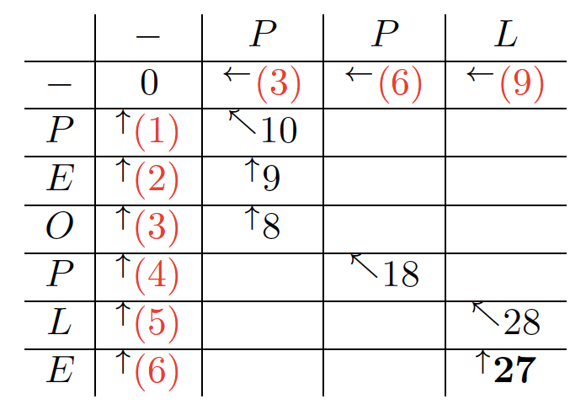

Filtering: Viterbi example
Gap penalties: -3 or -1
Match score: 10
Mismatch score: varying
sim(ppl, people) = 27/30
Filter out low similarity
Multiply by sim

Slide 11


Final Correction Candidates
Scale by ln(frequency) of the candidate where w is the original word and c is the candidate
If w exists in dictionary, add to list of candidates with maximum score
Remove any duplicate candidates, keeping the entry with the maximum score
Trim list to candidates within 70% of maximum score

Slide 12
Word Correction Evaluation
List of most frequent non-dictionary words
Manually mapped 378 to probable correction(s)
Record error if the candidate correction list has no overlap with probable corrections
Results: 80 errors
tryna, kd, thot, cuz

Slide 13
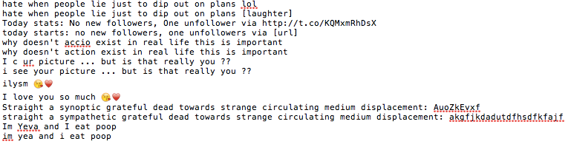
Text Correction Example
Replacements:
“@user” —> [username]
“#hashtag” —> [hashtag]
“http(s)://…” —> [url]
Using single word correction and phrase abbreviations

Slide 14
Bigram Correction

Slide 15
Issues
Proper names and acronyms, e.g. Cersei
Unusual words, e.g. accio
Metadata lost and/or unconsidered: capitalization, emoji, hashtags
Ambiguous abbreviations, e.g. kd
Abbreviations for multiple words, e.g. tryna
Aesthetically split words, e.g. P R E T T Y
Slang, e.g. thot

